Slide 1

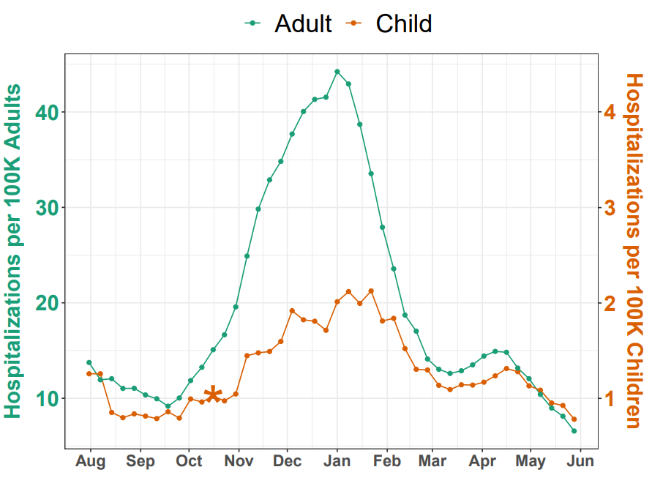
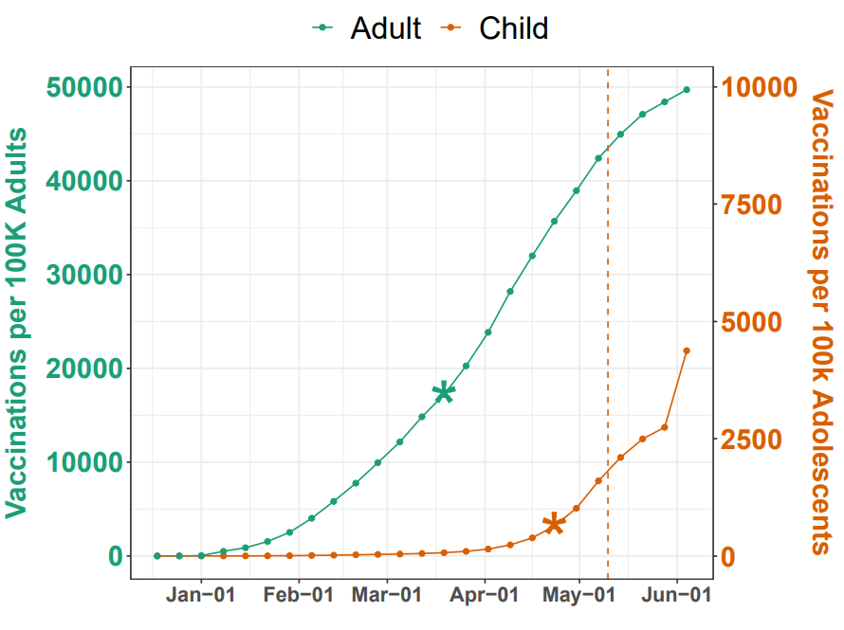
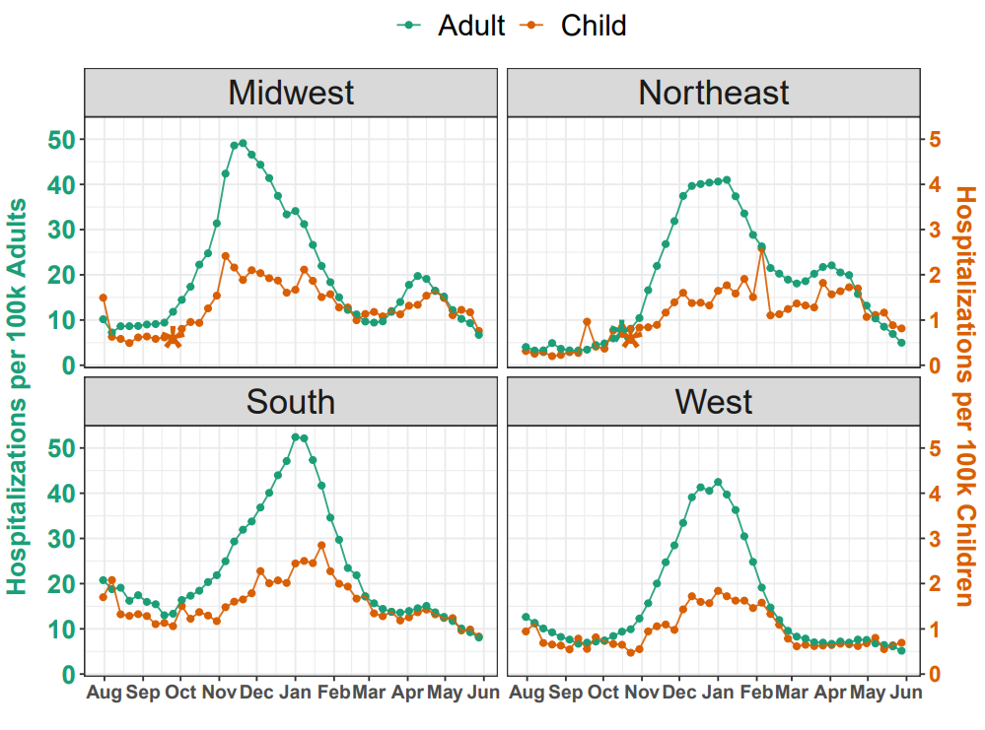
National Trends in Disease Activity for COVID-19 among Children in the US Meghan R Hutch,¹ Molei Liu,² Paul Avillach MD, PhD,^{3,4} Yuan Luo PhD,¹ Florence T Bourgeois, MD, MPH^{3,5}
¹Department of Preventive Medicine, Northwestern University, Chicago, IL ²Department of Biostatistics, Harvard T.H. Chan School of Public Health, Boston, MA, ³Department of Pediatrics, Harvard Medical School, Boston, MA, ⁴Department of Biomedical Informatics, Harvard Medical School, Boston, MA, ⁵Pediatric Therapeutics and Regulatory Science Initiative, Computational Health Informatics Program (CHIP), Boston Children’s Hospital, Boston, MA
Background
National & Regional Hospitalization Trends
Vaccination Trends
As of mid June, over four million pediatric COVID-19 cases have been reported in the US.¹ However, the epidemiology of COVID-19 in children is still poorly understood.
Evaluating COVID-19 trajectories in pediatric populations can help inform pediatric vaccination strategies, return to school, and disease management.
As vaccine rollout for children continues, evaluation of disease activity will help identify geographic regions where pediatric vaccination efforts should be prioritized and quantify the impact of vaccines on achieving heard immunity across both populations.
Methods
In July 2020, the United States issued a federal mandate requiring hospitals to report daily COVID-19 hospitalizations²
We examined the weekly counts of hospitalized patients with a laboratory positive COVID-19 test on admission
Vaccination data were obtained for adults and adolescents 12-17 years³
Trends were examined at both the national and regional level starting July 31, 2020 to June 3, 2021
Univariate change point analysis was used to identify the date at which there was an upward shift in mean hospitalization or vaccination rate
Cumulative vaccinations were standardized per 100,000 children or adults using US Census population estimates. The scale for pediatric vaccinations is 5-fold less than for adults. Asterisks indicate significant (P <0.004) change points. Dashed line demarks FDA EUA for adolescents 12-15 years of age.
Conclusions
At the national level, peak COVID-19 hospitalization rates were 20-fold less for children than adults.
Regionally, variation exists in hospitalization rates and timing of changes in disease activity. Consideration of regional variation is critical for best informing local and national policies for disease management and vaccination strategies.
As pediatric vaccination rates continue to increase, further investigation is needed to evaluate the impact of vaccines on hospitalization rates and disease burden across different segments of the population.
Hospitalization Rates
 | Children | Adults
NATIONAL | 1.2 (1-1.6) | 14.3 (11.9-28.4)
Midwest | 1.3 (1-1.7) | 15.1 (9.7-27.8)
Northeast | 1.1 (0.8-1.6) | 18.6 (6.4-26.5)
South | 1.4 (1.2-2) | 17.9 (14.3-30.3)
West | 0.8 (0.6-1.2) | 9.5 (7.2-21.2)
References
American Academy of Pediatrics and the Children’s Hospital Association. Children and COVID-19: State Data Report. Updated June 10, 2021. Accessed June 16, 2021. https://downloads.aap.org/AAP/PDF/AAP%20and%20CHA%20-%20Children%20and%20COVID-19%20State%20Data%20Report%206.10%20FINAL.pdf
COVID-19 Reported Patient Impact and Hospital Capacity by State Timeseries. HealthData Web site. Updated June 6, 2021. Accessed June 6, 2021. https://healthdata.gov/Hospital/COVID-19-Reported-Patient-Impact-and-Hospital-Capa/g62h-syeh
Demographic Trends of People Receiving COVID-19 Vaccinations in the United States. Center for Disease Control and Prevention. Updated June 11, 2021. Accessed June 11, 2021. https://covid.cdc.gov/covid-data-tracker/#vaccination-demographics-trend
https://github.com/meghutch/COVID-19-Hospitalization-Trends
Hospitalizations were standardized per 100,000 children or adults using US Census population estimates. The scale for pediatric hospitalizations is 10-fold less than for adults. Asterisks indicate significant (P <0.004) change points. Dashed lines demark vaccination change points.
Median and interquartile range of hospitalizations per 100,000 children or adults.

